Slide 2
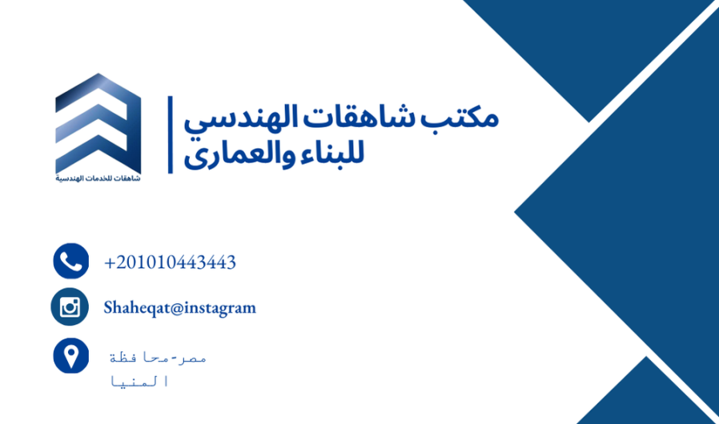

Business brief
Shaheqat engineering services office
Offers multiple services:
Interior design.
Architecture.
Construction services.
Located in Minya serving whole upper Egypt area.
Their online presence is restricted to Facebook and integral and mainly facing an issue with low awareness despite their strong high quality protofolio.
-thus our aim is to raise the awareness of the brand through multiple channels.

Slide 3
Market analysis: Pest analysis
Political | Economical | Social | Techological
The company ensure compliance with building codes and zoning laws when designing interiors for both residential and commercial properties. understanding Egypt’s tax regulations is crucial, including Value Added Tax on goods and services. Any changes in tax policies or increases could affect project apricing. Any political instability could affect economic conditions, construction projects, and overall consumer confidence. Egypt is undergoing urban expansion projects and other real state investement, hese could provide significant opportunities for interior design firms to tap into new markets. | 1-Currency Fluctuations: The Egyptian pound is experiencing fluctuations in recent years, affecting the cost of imported materials. The company may need to adjust pricing strategies accordingly or seek out local suppliers to mitigate risks. 2-A growing middle class and upper-class segment in New minya are increasingly investing in luxury goods, property development, and personal space enhancements. 3-Cost of Materials and Labor: Inflation in material costs (especially for imported goods) and rising labor costs could impact project profitability. The company may need to balance between competitive pricing and maintaining quality. | 1-Cultural Preferences: residents of new mina have strong cultural preferences for specific interior design styles, including a mix of traditional and modern elements. The company must understand and cater to these preferences to appeal to the local market. 2-Lifestyle Changes: Recent trends lifestyle changes have increased demand for home office designs, renovations for home-based activities, and personalized living spaces. This could open new market opportunities for the company. 3-New minya urban areas are expanding rapidly, with an increasing population. This urbanization trend presents opportunities for the company to serve a growing client base in city dwellings and new residential developments. 4-Consumer Behavior: Egyptians are increasingly influenced by global design trends seen on social media platforms like Instagram, Pinterest, and TikTok. This presents an opportunity for the company to showcase its work online to attract a wider audience, especially younger, trend-conscious consumers. | Interior design companies in are increasingly relying on advanced tools like 3D modeling, virtual reality (VR), and augmented reality (AR) to showcase designs to clients. Investing in such tools could set the company apart from competitors by offering immersive experiences. E-commerce and Online Presence: Having a strong online presence is critical for gaining visibility. Leveraging social media marketing, websites, and online portfolios can help attract clients. Additionally, offering online consultations can appeal to tech-savvy customers. Utilizing project management software and digital platforms to streamline project timelines, communicate with clients, and track costs could increase efficiency and client satisfaction. There's growing interest in eco-friendly design and sustainable materials. The company could explore offering green design solutions, energy-efficient interiors, and smart home integration as part of its services, aligning with global trends and environmental consciousness.

Slide 4
Market analysis: Swot analysis
Strength | Weakness
1-however the company is new to the market, it accomplished multiple projects that showcase its capability to the potential clients. Successful portfolio. 2-the skills and potenials of the design team is highly creative and proficient. 3-Personalised customer services as the company is very focused on each client detail. 4-The company offers competitives pricing to attaract new customer considering that all projects are cost effecient | Limited brand recognition as the company lack strong brand awareness. Limited resources either financial or employees. Despite the accomplished projects, the high profile clients may look for/ prefer well established company. Lack or robust marketing and sales team.
Opportunities | Threats
Increased interest in home improvements, office redesigns, and personalized spaces create significant market opportunities. Expanding and building strong online presence by reaching more audience and showing case the company portfolio. Collaborating with real estate developers to expand business opportunities. Targeting niche markets such as luxury interiors and heat resistant. | Competing with well established firms with loyal clients and expensive protfolio. Inflation and fluctuation in the Egyptian currency reduced the demand for interior design as luxurios service. Rising the cost of materials may impact the profability of the projects. Difficulty in meeting client expectations. Maintaining the design quality among projects.

Slide 5
Market analysis: customer analysis
 | House owners | Business owner | Real estate developers
Demographic | · Age: 22-45 years old. Income: Middle-to-upper class. Location: Minya and its governorates. Family Size: young couples, and families | · Industry: Retail, hospitality, restaurants, cafes, office spaces, etc. Location: Primarily in Minya and areas around areas, with a focus on high-traffic business districts. Size of Business: Small to medium-sized enterprises and emerging brands. | · Age: 35-55 years old. · Industry: Real estate, property development (both residential and commercial). · Location: Urban centers and emerging new cities like the New Administrative Capital. · Business Type: Developers working on large-scale projects (e.g., residential buildings, office parks, commercial malls).
Psychographic | · Lifestyle: Value design, , durability and functionality; follow design trends on social media. Values: They are looking for spaces that reflect their personality, success, and family lifestyle. Pain Points: They may feel overwhelmed by design choices and seek expert guidance to bring their vision to life. | · Lifestyle: Prioritize customer experiences and brand image, viewing interior design as an integral part of their business identity. · Values: Focus on functionality, brand alignment, and creating spaces that attract customers and reflect their business ethos. · Pain Points: Need quick turnarounds, budget constraints, and high expectations for design impact on customer engagement. | · Lifestyle: Profit-oriented, but value high-end, attractive designs that enhance the marketability of their properties. · Values: Quality, efficiency, and the ability to meet buyer/tenant expectations. · Pain Points: Require design solutions that appeal to a broad market, with a strong focus on functionality, aesthetics, and time efficiency.
Behavioral | · Engagement: Use platforms like Pinterest and Instagram to gather design ideas. · Purchase Intent: Interested in customized, stylish, and functional home designs. · Budget: Varies, but most seek good value for money while balancing style and quality. | · Engagement: Research competitors' spaces and trends; seek solutions that blend aesthetics with practicality. · Purchase Intent: Desire designs that create a competitive edge and enhance customer experience. · Budget: Varies based on the size of the business, but often mid-range with a clear focus on ROI. | · Engagement: Constantly review market trends and competitor developments. · Purchase Intent: Looking for design services that add value to properties and increase sales or rental potential. · Budget: Willing to invest more, as long as there’s a clear return on investment (ROI) and the design aligns with project timelines.
Geographic | Minya | Location. Minya density.

Slide 6
targeting
Targeting strategy:
House Owners (Primary Target Market):
Target Group:
House owners represent the largest and most diverse segment with constant demand for interior design services
Young professionals, families, and middle-to-upper class homeowners looking for stylish, functional, and personalized home designs
Focus and pain points..
· Personalized design solutions: Offer tailored designs to reflect individual tastes and lifestyles.
· Affordability with style: Position the company as offering high-end, modern designs that are accessible and affordable to a wider audience.
· Social media engagement: Utilize platforms like Instagram and Pinterest to showcase home design projects, provide tips, and connect with customers seeking inspiration.

Slide 7
positioning
A. Positioning for House Owners
Positioning Statement: "We help homeowners transform their spaces into beautiful, functional, and personalized havens that reflect their unique lifestyle and taste. Our affordable luxury designs offer style and comfort without compromising on quality."
Key Differentiators:
Affordable luxury: Providing high-quality designs that feel luxurious but are priced to be accessible.
Personalization: Each home is tailored to reflect the client’s personality, lifestyle, and aesthetic preferences.
Stress-free service: End-to-end project management that takes care of every aspect of the design, so homeowners can relax and enjoy the process.

Slide 8
Competitive edge
-Competitive edge :
Personalized and culturally integrated designs that reflect both modern trends and personal preferences.
High-quality craftsmanship and a focus on premium materials to create lasting, sophisticated interiors.
Technology-driven solutions that offer immersive, visual experiences to clients, making the design process more engaging and transparent.
A sustainability-first approach that caters to the growing demand for eco-friendly designs.
A strong presence on social media and a reputation for client-oriented service excellence.
Specialization in commercial and real estate design, positioning the company as a strategic partner for businesses and developers looking for ROI-driven design solutions.
. Scalable Solutions for Various Client Segments
Adaptable Design Packages
Create scalable design packages that cater to different budget levels, from basic consultations for DIY homeowners to full-service design and execution for premium clients.
Flexible Payment Plans
Offering flexible payment structures or financing options can make interior design services more accessible to a broader audience, helping the company capture mid-market clients while still catering to high-end projects

Slide 9
customer analysis: persona
مكتب خدمات هندسية
Buyer Persona:
• Name: Sara the Homeowner
• Age: 28-45 years old
• Location: Minya, Egypt, and surrounding areas in Upper Egypt
• Interests: Home improvement, interior design, and creating a functional living space
• Language: Arabic
• Gender: Female
• Education: High school diploma or university degree
• Social Status: Married, likely with children
• Income: Middle-income, moderate budget for home-related projects
• Occupation: Teacher
• Websites Visited: Google - Facebook – Instagram – Pinterest – YouTube
• Obstacles That May Hinder Buying My Service:
1. Budget Constraints
2. Lack of Expertise
3. Overwhelmed by Choices
4. Fear of Low-Quality Work
• Motives to Buy My Service:
1. Quality Assurance: She wants expert services that ensure her home renovations are done correctly
and built to last.
2. Peace of Mind: Knowing that an engineering professional will take care of technical details while she
focuses on design and comfort.
3. Value for Money: Balancing cost-effectiveness with high-quality service to avoid future repairs or
headaches.
4. Aesthetics and Functionality: Ensuring her home is not only structurally sound but also comfortable
and visually appealing for her family.
• Online Behavior:
1. Social Media User: Regularly checks Facebook and Instagram for inspiration and local
recommendations.
2. Search-Oriented: Frequently uses Google to search for local services, home improvement advice, and
reviews.
3. Word of Mouth Dependent: Likely to rely on online reviews, ratings, and personal recommendations
from social media groups.
4. Visual Learner: Consumes visual content like before-and-after renovation photos, interior design
posts, and video tutorials.
• Goals That May Achieve via My Service:
1. Improved Home Environment: Creating a more comfortable, functional, and aesthetically pleasing
home.
2. Long-Term Investment: Building or renovating a home that will last for years without needing frequent
repairs or renovations.
3. Hassle-Free Experience: Getting expert help to complete projects without stress or confusion about
technical details.
4. Budget Management: Maximizing the value of her investment by ensuring the job is done right the
first time.

Slide 10
Objective
Expanding the brand presence through tiktok and pintrest-increasing followers on instragram and facebook by 10 % while one month..
Objective: increase online reach to 500 followers and increase engagement by 20% within 3 weeks

Slide 11
strategy
Social media channels: pintreset, tiktok, facebook,instagram.
Content calneder,voicetone,postine time,
Email marketing.
Paid ads
Articles, images, videos.
Using more online channels such as tiktok.
Increasing frequency of the posting .
Creating more videos.
Using offline channels such as banners and flyers.
Building strong brand recognition .
Positioning: A modern interior design company combining creative innovation with traditional Egyptian aesthetics.
Voice and Tone: Professional yet approachable, with an emphasis on creativity, elegance, and attention to detail.
Visual Style: Clean, elegant visuals with a focus on high-quality images, behind-the-scenes videos, and mood boards. Consistent use of colors and fonts in all posts to reflect the brand identity.

Slide 12
Content calendar
Content | media | CTA | Channel | Time | Funnel
قبل وبعد: "اتفرج على مشروعنا الجديد اللي خلينا فيه المساحة دي من (صورة قبل) لـ (صورة بعد)! فرق كبير، صح؟ قولنا إيه أكتر حاجة عجبتك في التصميم ده؟ 💬💡" | Image/post/story | Like&follow | Facebook Instagram | 10Sep | awareness
فيديو خلف الكواليس: "ده جزء من الشغل اللي بنعمله علشان نطلع التصميمات الجميلة دي! دايمًا في تفاصيل كتير بتفرق في الآخر. 🛠️✨" | Video-post/story | Like&follow | Tiktok Facebook instagram | 11Sep | awareness
تايم لابس لتجديد غرفة: "من (قديم) لـ (جديد) في دقايق! إيه رأيك؟ جاهز للتغيير ده في بيتك؟ 🤩🏡 #ديكور #تصميم" | Video/post/story | Like&follow | Tiktok | 12Sep | awareness
لوحة إلهام: "أفكار عصرية لغرف نوم مميزة تجمع بين البساطة والرقي. شاركنا ذوقك في التصميم!" | Image/post/story | Like&follow | Facebook | 13Sep | awareness
نصائح للألوان: "لون الحيطة بيفرق كتير في إحساسك بالغرفة. لون دافئ ولا بارد؟ اختار بعناية واخلق الجو اللي تحبه. 🎨👌" | Video/post/story | Like&follow | instagram | 14Sep | awareness
Reel لمجموعة تصميمات: "شوف ٣ أفكار لتصميم مساحات المعيشة تناسب مختلف الأذواق! إيه أكتر حاجة عجبتك؟ #ديكور_بيتك" | reel/post/story | Like&follow | Tiktok | 15Sep | awareness

Slide 13
Content calendar
Content | media | CTA | Channel | Time | Funnel
تحدي تحويل مساحة صغيرة: "ازاي نقدر نحول أوضة صغيرة لمساحة مريحة وكبيرة؟ تابع الفيديو وشوف بنفسك! 👀🛋️" | Image/post/story | Like&follow | Facebook | 16Sep | awareness
مخطط تصميم غرفة: "ديزاين مميز لغرفة معيشة مودرن. تحب تضيف أي تعديلات؟ 👇" | iimage/post/story | Like&follow | instagram | 17Sep | awareness
استطلاع صيحات التصميم: "أنت مع التصميمات الكلاسيك ولا المودرن؟ قولنا رأيك وصوت معانا في الاستطلاع! 🏠🛋️" | poll/post/story | Like&follow | Tiktok | 18Sep | awareness
فيديو قصير لأفكار ديكور الحوائط: "الحوائط مش مجرد فراغ! شوف معانا إزاي تزينها بطرق مبتكرة. 🎨🖼️" | Video-sreels | Like&follow | instagram | 5 October | Engagement
فيديو لنصائح الإضاءة الطبيعية: "ازاي تخلي بيتك يستفيد من الإضاءة الطبيعية لأقصى درجة؟ ☀️🏡 #ديكور_منزلي" | Video | Like&follow | Tiktok | 6 October | Engagement
تصاميم مودرن لغرف السفرة: "غرف سفرة بديزاينات مودرن وفريدة. إيه التصميم اللي يعجبك أكتر؟ 🍽️✨" | Images-storeis | Like&follow | Facebook | 7 October | Engagement
قبل وبعد لإعادة تصميم مساحة العمل: "عايز مكتب مريح وأنيق؟ شوف إعادة تصميم مكتب صغير للمزيد من الإنتاجية! 🖥️💡" | Video | Like&follow | Tiktok | 9 October | Engagement
نصائح لتنظيم المساحات الصغيرة: "لو بتعاني من ضيق المساحة، اتفرج على الفيديو ده هتلاقي حلول بسيطة ومفيدة! 📦🏠" | Video-reel | Like&follow | Facebook | 10 October | Engagement
أفكار لتجديد الأثاث القديم: "لو عندك قطع أثاث قديمة، الأفكار دي هتديها حياة جديدة وتخليها متماشية مع موضة السنة دي. 🔄🛋️" | images | Like&follow | instagram | 11 October | Engagement

Slide 14
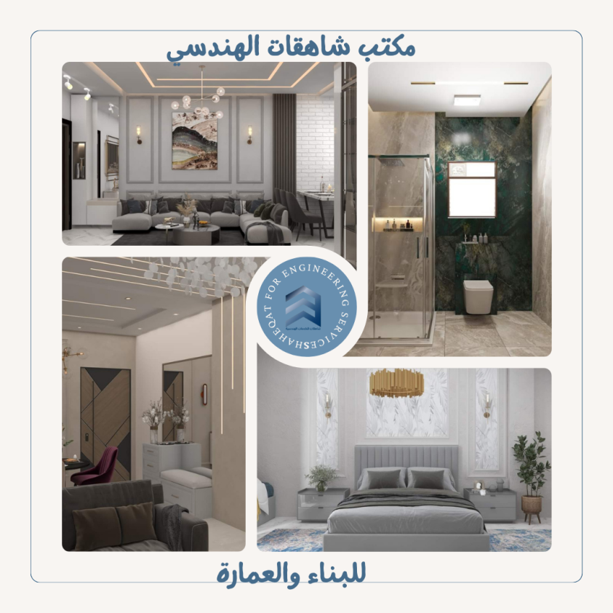
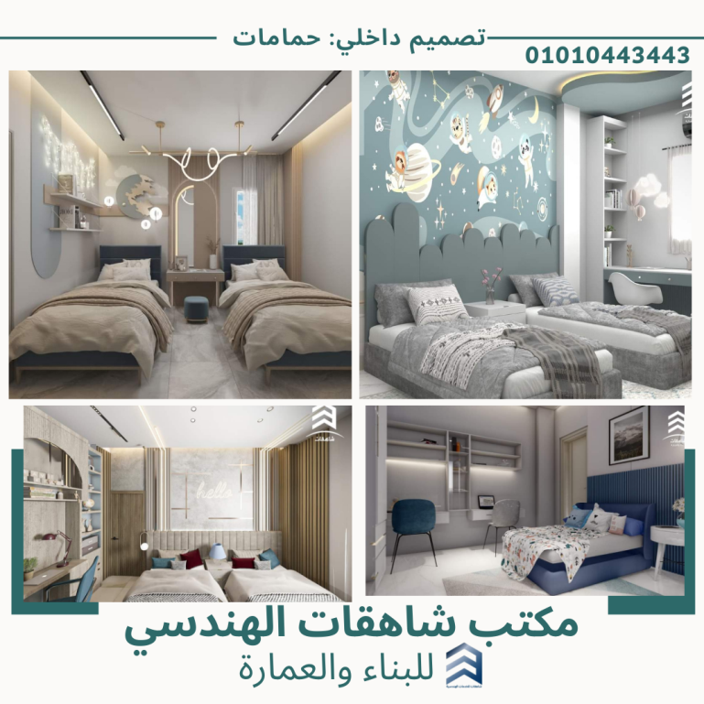
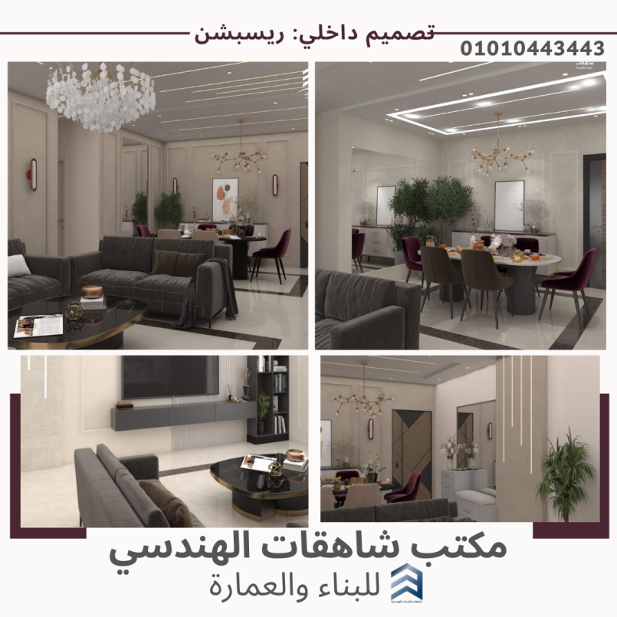
Content creation and type of content
Type of content: awareness, showing case of the company portfolio.

Slide 15
Content creation and type of content
Type of content: awareness, showing case of the company portfolio.

Slide 16
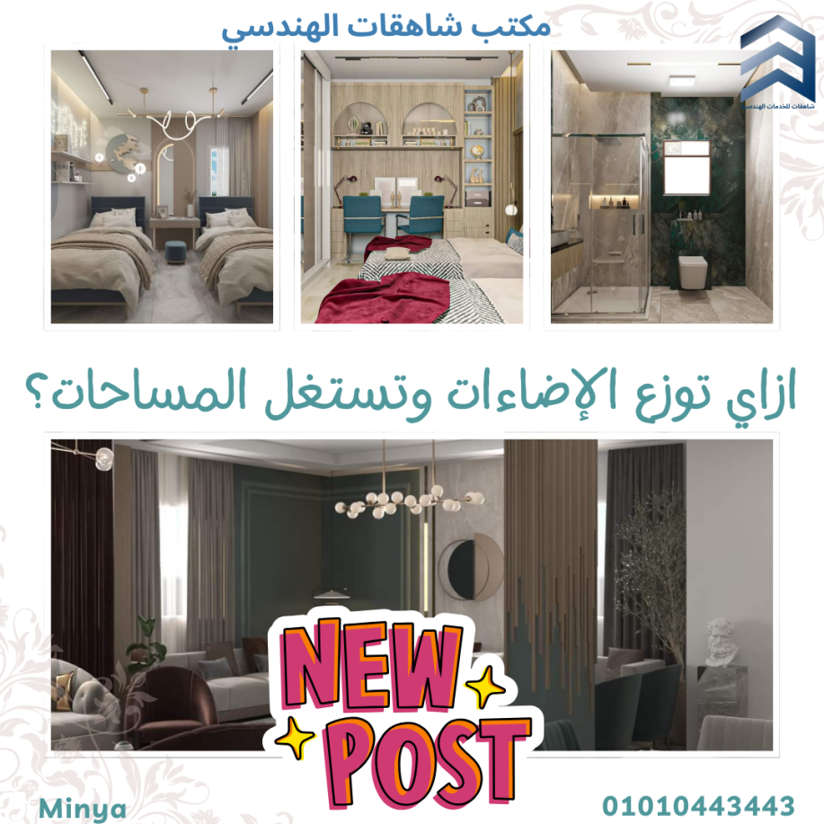
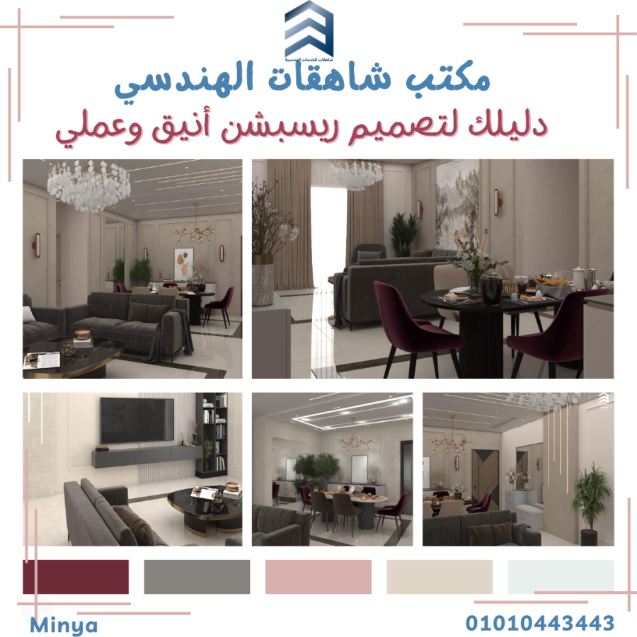
Content creation and type of content stories
Type of content: awareness, showing case of the company portfolio.

Slide 17
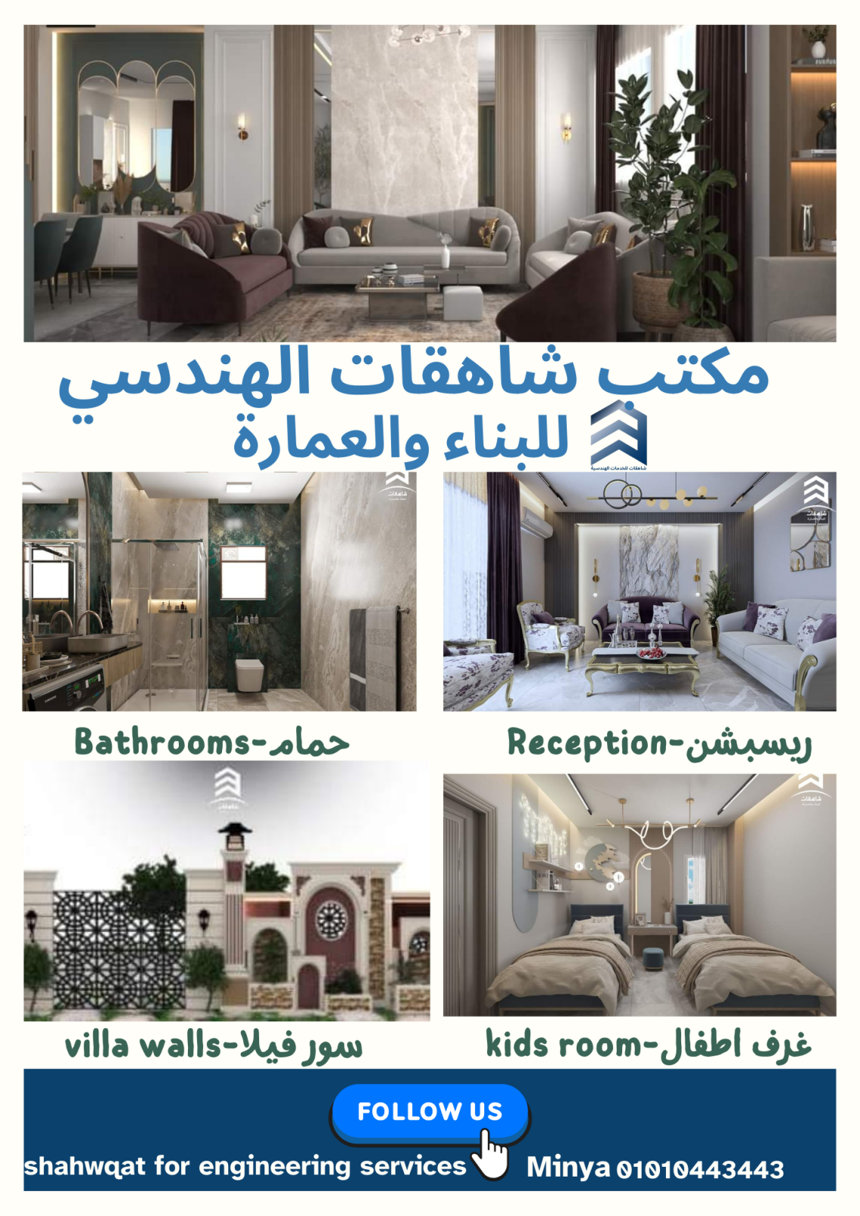

Slide 18
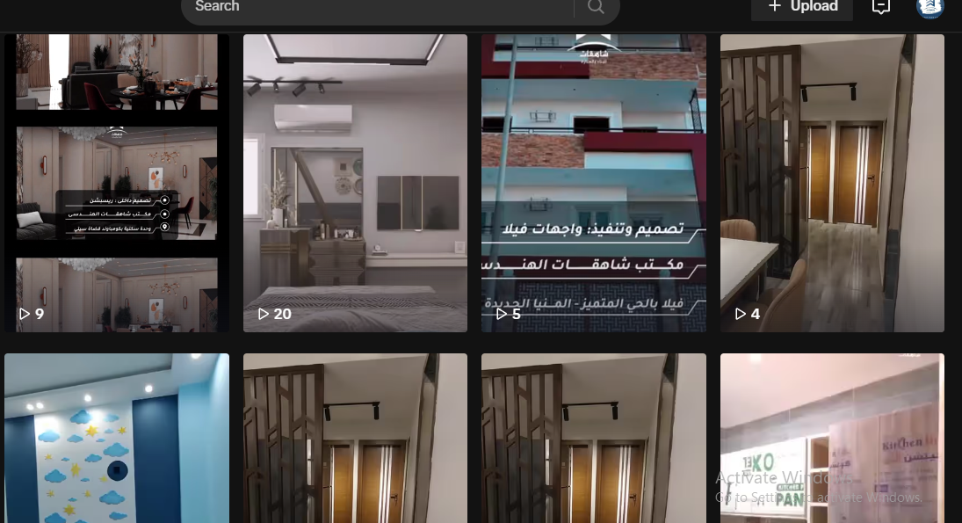
Content creation and type of content
Type of content: video, reels

Slide 19
Tactics
· Key Platforms:
Instagram: Visual storytelling and portfolio display.
Facebook: Community building and sharing detailed content (e.g., project stories).
Pinterest: Idea boards for design inspiration and mood boards.
LinkedIn: B2B connections with real estate developers and commercial clients.
TikTok: Short-form content showcasing creative processes and transformations.
Brand Identity:

Slide 20
Campaign management

Slide 21
analytics
Tools: google analytics.
Views
Conversion rate
Engament
Roi
Evaluate resaults based on objective.

Slide 22
suggestions
Suggest some enhances for the campaign based on what awas wrong.
Suggest what makes next campain better.

